Slide 1

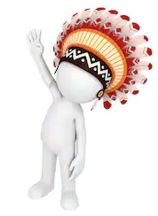
Gestational Glucose Tolerance and Risk of Type 2 Diabetes in Pima Indian Living in United States.
.

Slide 2
Guided question
The relationship among gravidity, obesity, and non-insulin-dependent mellitus in “Pregnant Pima Indians”. A study of diabetes were evaluated in both cross-sectional and longitudinal analyses.
OBJECTIVE:
Type 2 diabetes and obesity have genetic and environmental determinants. We studied the effects of different environments on these diseases in Pima Indians in Mexico and the U.S.

Slide 3
Introduction:
The term diabetes is the shortened version of the full name Diabetes Mellitus.
Diabetes mellitus is derived from the Greek word diabetes meaning siphon - to pass through and the Latin word mellitus meaning honeyed or sweet.
All because in diabetes excess sugar is found in blood as well as the urine. During the17th century it was known as the “pissing evil”.

Slide 4
Data Sourcing and Data Preparation
This data was collected by the National Institute of Diabetes and Digestive and Kidney Disease .
The Dataset had 768 individual records and 9 columns.
Since over 347 of the rows have missing or unacceptable values a bit of data cleaning and manipulation was required.
Since dropping all values with missing or unacceptable values will reduce the sample size by more than 40 %, it was decided to replace such values with imputed means from the available data- pandas used.
The “class” column (the dependent variable), which was a categorical variable in the original data was also converted to numeric indices.

Slide 5
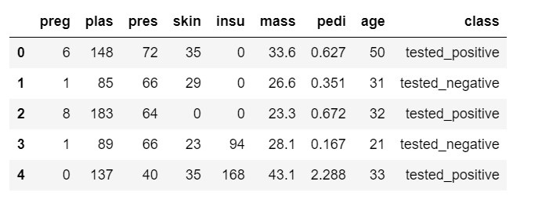
Sample of the raw data obtained
.

Slide 6
Description of data columns
1. Preg = Number of times pregnant
2. Plas = plasma glucose concentration 2 hours in an oral glucose tolerance test
3. Pres = Diastolic blood pressure (mm Hg)
4. Skin = Triceps skin fold thickness (mm)
5. Insu = 2-hour serum insulin (mu u/ml)
6. Mass = body mass index (weight in kg/(height in m)^2)
7. Pedi = diabetes pedigree function
8. Age = age (years)
9. Class = class variable (0 or 1(

Slide 7
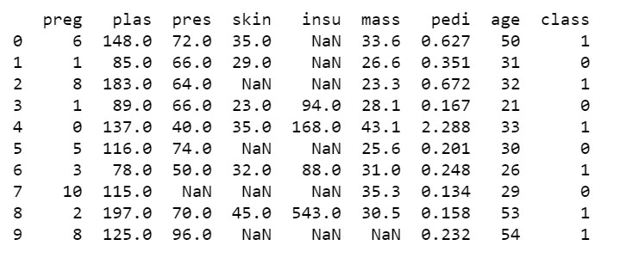
Data cleaning continued…
Before they can be replaced with imputed means, Unacceptable and missing values are replaced with NaN . Categorical values have already been replaced with numeric values of 0 or 1 (Col 8)

Slide 8
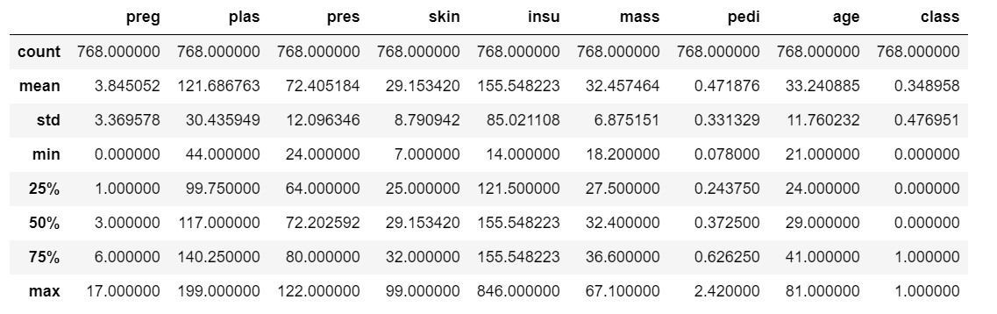
Description of Dataset at different values after NaN values have been replaced with imputed means
Missing values have been imputed for and Minimum values of 0 are shown where they could be logically explained.

Slide 9
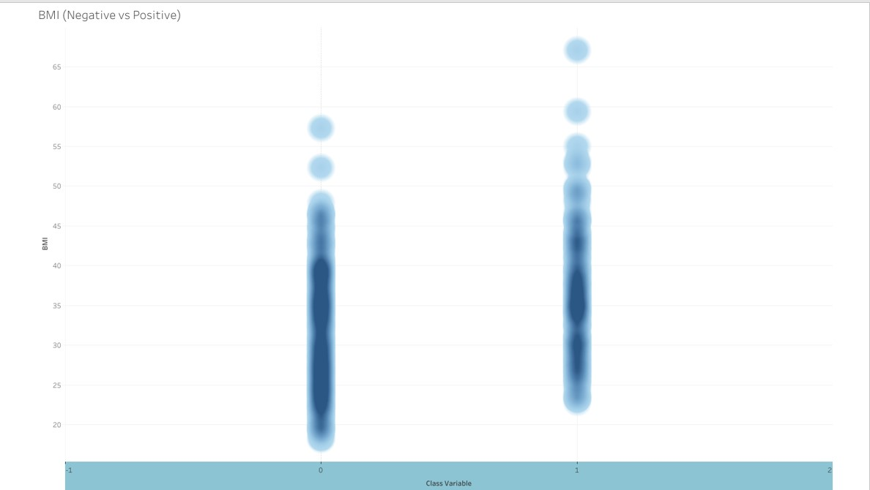
BMI (Negative vs Positive)
This graph compares the recorded BMI data for each individual in the study with a positive and negative result. The darker the portions of the graph show a higher concentration of individuals with BMI (or other variables in future graphs) at that value. As you can see, individuals that tested negative were more likely to have a lower BMI.

Slide 10
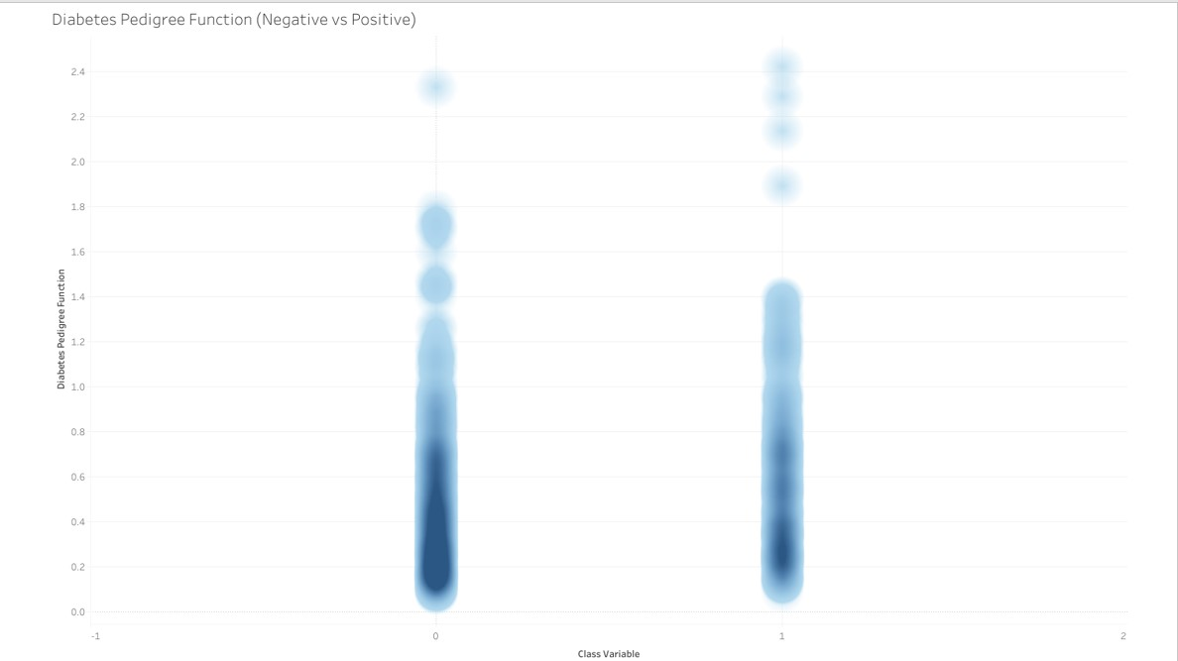
Diabetes Pedigree Function ( Negative vs Positive)
This shows the Diabetes Pedigree Function for individuals that tested positive and negative.

Slide 11
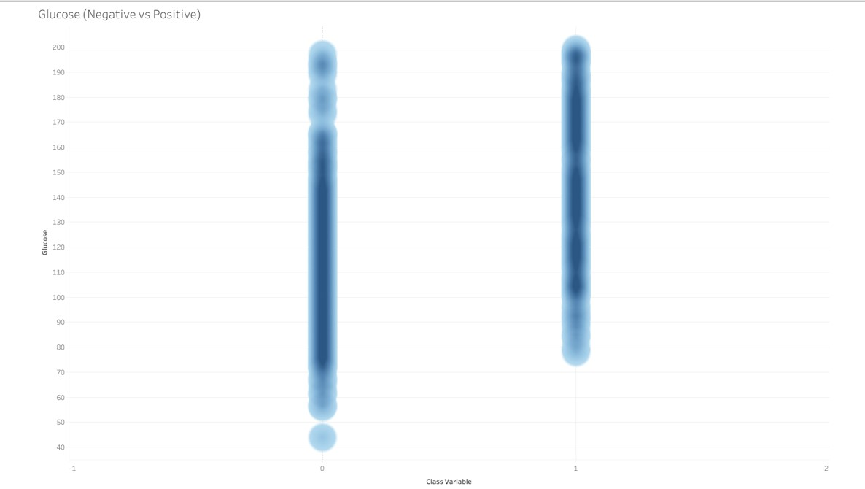
Glucose ( Negative vs Positive)
This shows the Glucose levels for individuals that tested positive and negative. The glucose level for individuals that tested positive is concentrated at a higher glucose level than those that tested negative.

Slide 12
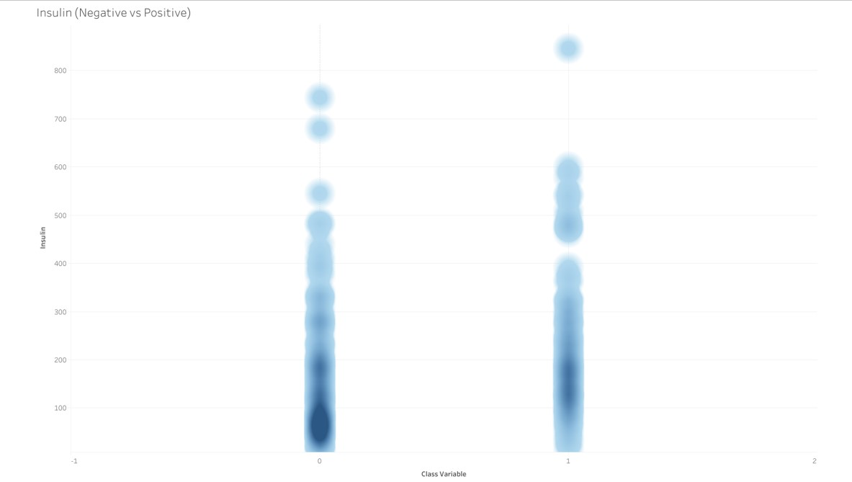
Insulin ( Negative vs Positive)
This shows the Insulin levels for individuals that tested positive and negative. The insulin level for individuals that tested positive is concentrated at a higher level than those that tested negative.

Slide 13
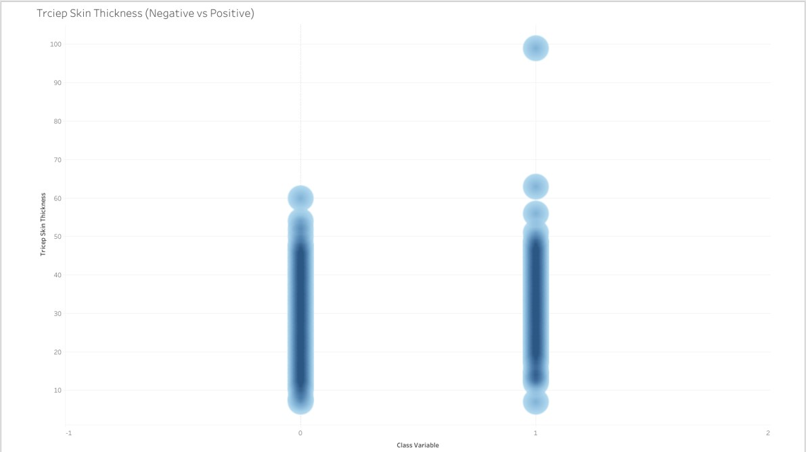
Triceps Skin Thickness (Negative vs Positive)
This shows the Triceps Skin Thickness for individuals that tested positive and negative.

Slide 14
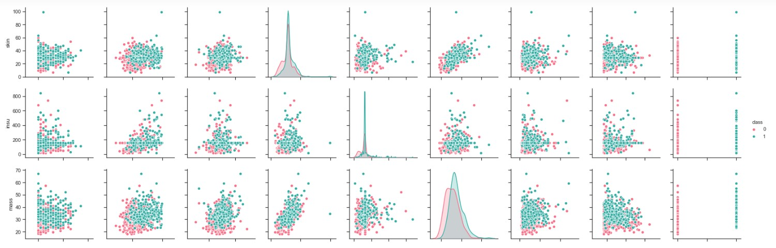
Plotting with all eight variables
Skin
Insu
Mass
perg
plas
pers
skin
insu
Mass
pedi
age
class

Slide 15
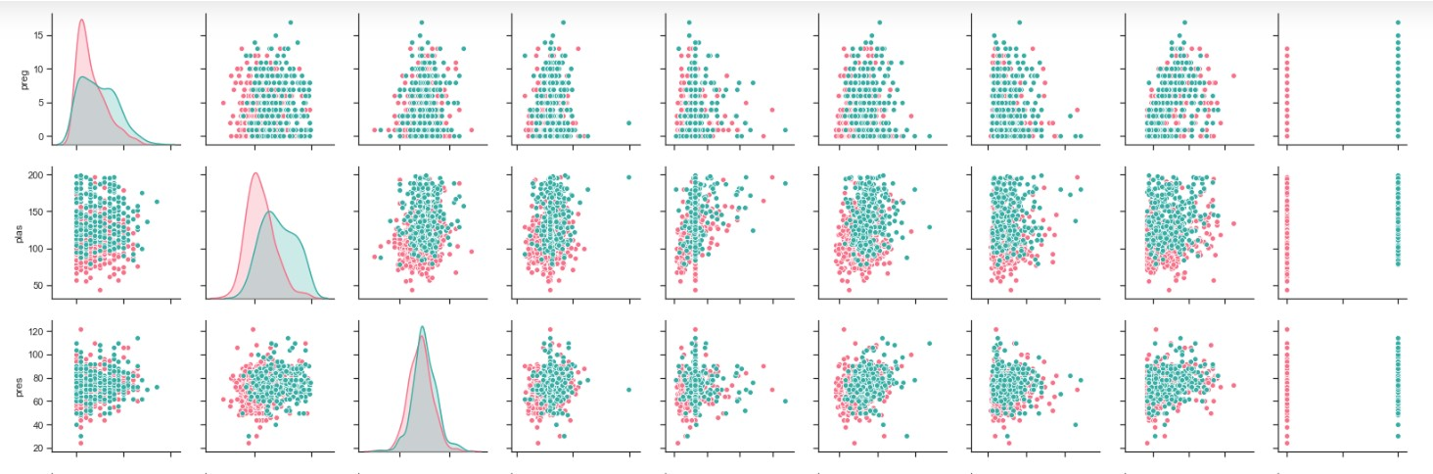
Preg
plas
press
perg
plas
pers
skin
insu
Mass
pedi
age
class

Slide 16
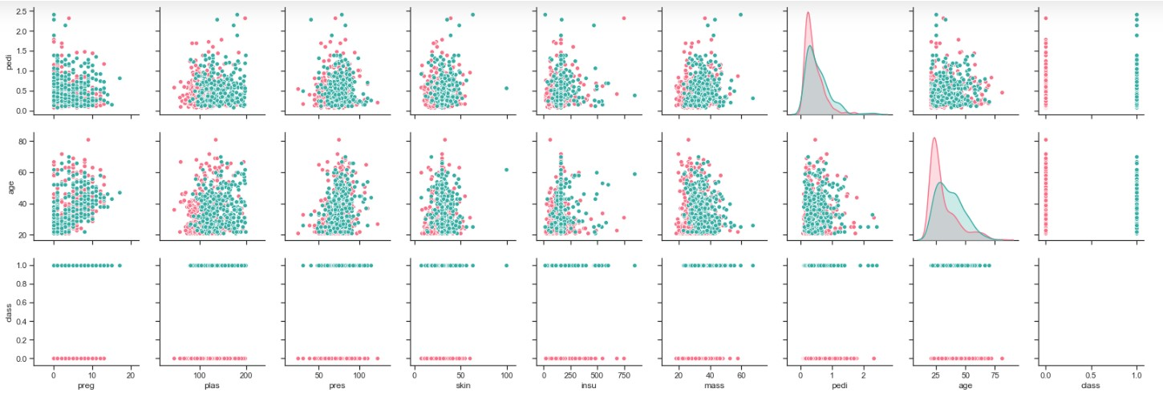
pedi
age
class
perg
plas
pers
skin
insu
Mass
pedi
age
class

Slide 17
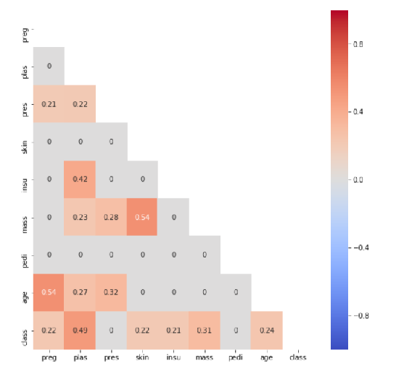
Heatmap
Heat map showing
the relative
strength of
correlation among
the various
independent
variables and with
the dependent
variable

Slide 18


Major Conclusions drawn from the Data analysis :
Among the eight variables looked, Glucose levels and BMI are shown to have the strongest correlation with diabetes diagnosis.
Surprisingly, blood pressure is found to have a very insignificant correlation with diabetes incidence. Blood pressure is found to have a stronger correlation with age than with diabetes
At least from a commonsense perspective the fact that diabetes pedigree function has a very limited correlation with diabetes diagnosis was a surprising one.
Visit O GitHub blog

